Slide 1
Module 1: Planning Activate SharePoint Online Migration
Ethan Irons

Slide 2
Conditions and Terms of Use

Slide 3
How to view this presentation?
To switch to the Notes Page view:
On the ribbon, select the View tab, and then select Notes Page
To navigate through notes, use the Page Up and Page Down keys
Zoom in or zoom out, if required
In the Notes Page view, you can:
Read any supporting text—now, or after the delivery
Add notes to your copy of the presentation, if required
Take the presentation files home with you

Slide 4
Objectives

Slide 5
Sections
In this lesson, you will learn:
Plan for Migration
Migration Workloads
Go-Live Cutover Considerations
Modernization
Plan for Communication

Slide 6
Plan for Migration

Slide 7
Plan for Migration Overview
Migration to SharePoint Online is a project management challenge!
Start with your business goals, not technical requirements.
Engage stakeholders and change champions.
Perform assessment of your data sources.
Prepare the target M365 environment.
Map workloads between environments.
Choose a migration approach and cutover strategy.
Select a migration tool or service.
Communicate early and often with your users.
Notes:
Think of your migration as a challenge in Project Management – not a technical problem. There will be technical hurdles and challenges along the way, but with the right project management
Frame your migration around the key business goals rather than around technical requirements – “Want a modern approach to team collaboration with access from any device” instead of “Want to have this business unit content moved over there
Communication Planning – incorporate this into your upfront planning.
Communicate early and often with your users about the migration and how it will impact them.
Don't wait until the very end to start preparing them for the change.

Slide 8
Migration Approaches
For each SharePoint site (or file share) consider the following approaches:
Leave behind
Lift and Shift
Rebuild - Modernize
Identify stale content.
Archive.
Leave behind.
Migrate with as little change as possible.
Classic sites.
Generally, not recommended (more on this later)
Optimize for target platform.
Modern sites and features.
Recommended.
Notes:
This is just high-level overview of the approaches; details will be covered later.
Leave it behind – Identify what you need to migrate and what you no longer need. Do not migrate more then you need to
Lift and Shift – Migrate structure and sites as-is, with as little change as possible. Generally, not recommended (More on this later). While not a preferred method customer can take what they have currently and just migrate it to SPO. While you might need to keep all the content, we should look to modernize the migration. More to come on this
Rebuild – Modernize: - optimize content and sites to adapt to the target platform. Use modern sites and features. Recommended. There are some items that can not be moved to SPO and must be rebuilt or redesigned. Examples SSRS, Solutions.
IMPORTANT: The migration should be more than just a lift and shift!

Slide 9

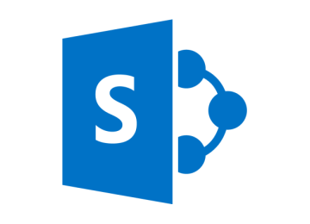








Identify Sources and Map Workloads
Microsoft 365 stores files in SharePoint Online / OneDrive for Business
Notes:
Migration Manager: Box, Egnyte, DropBox, Files Server, Google Workspace
SPMT: SharePoint Server, File Server
Mover.io: Google, Amazon S3, Azure Blob, Google Cloud Store, Egnyte, G Suite/Workspace, Office 365, Box, Dropbox
Migrate SharePoint Server sites to SharePoint Online and optionally connect to Microsoft Teams.
Home drives (P:\), or personal folders, migrate to OneDrive for Business.
Third-party storage and collaborations solutions should be evaluated, and features compared to target Microsoft 365 services.
Microsoft 365 stores files in SharePoint Online / OneDrive for Business Document Libraries.
Microsoft Teams is just a front end; the files will still reside in a SharePoint Online Document Library.

Slide 10

Microsoft’s FREE Migration Tools
Migration Manager
SPMT
There are MANY third-party migration tools available to purchase as well. ☺
(More on this in Module 4).
Notes:
Discuss the free migration tools from Microsoft and what sources they support:
Migration Manager: Box, Egnyte, DropBox, Files Server, Google Workspace
SPMT: SharePoint Server, File Server
Mover.io: Google, Amazon S3, Azure Blob, Google Cloud Store, Egnyte, G Suite/Workspace, Office 365, Box, Dropbox
Migration Manager is recommended for File Servers due to its orchestration/scalability.

Slide 11
Example Migration Planning Questions
What workloads will be migrated?
How to modernize the workloads?
Is hybrid configuration needed?
Cutover or a multi-phase transition?
What migration tool to use?
Will Site Owners validate migrations?
How long can data access be read-only?
What is the timeline to complete the migration?
Notes:
Just quickly cover some of the points and move on. We cover all of this in later slides / modules.
When you are thinking of a migration there are some questions you should consider.
We will discuss these in the sections in these modules.

Slide 12
SharePoint Migration Overview
Planning
What to expect before/after migration
Prepare your SharePoint environment
User creation Site creation
Migrate
Migration service providers
User onboarding
Send regular emails to users
Assess and remediate
Change management and communications
Plan for Modern team sites
Run SMAT
Remediate issues
Workflows
Tenant settings
Hybrid
Provide documentation for making the switch
Provide training
What content goes where
Understanding permissions vs sharing
Pre-provision Microsoft 365 and users
Assess key areas
Review migration offerings
Migration steps
Let users know how they are impacted
Network performance impact
Run SMIT
You are here.
You are here.
Notes:
Only introduce the pillars – do not go into details. Details will be covered later.
This slide will be presented various times throughout the presentation
Each time we revisit this slide it will be in context of a new Workload that needs to be migrated
Bold text represents the migration activities specific to the current workload being discussed

Slide 13
File Share Migration Overview
Planning
What content goes where
Prepare your environment
Pre-provision Microsoft 365 SPO Sites and users
Migrate
Review migration offerings
User onboarding
Send regular emails to users
Assess and remediate
Assess key areas
Understanding permissions vs sharing
What to expect before and after
Migration and network performance considerations
Change management and communications
Remediate issues
Microsoft FastTrack services
Migration service providers
Provide training
Let users know how they are impacted
SPMT Scans
File Share Permissions Planning
Migration Manager Scans
You are here.
Notes:
Only introduce the pillars – do not go into details. Details will be covered later.
This slide will be presented various times throughout the presentation
Each time we revisit this slide it will be in context of a new Workload that needs to be migrated
Bold text represents the migration activities specific to the current workload being discussed

Slide 14
Modernization

Slide 15

Modernization Overview
Modernization consists of two elements:
User interface and tools
Information architecture
Flatten the information architecture!
Prepare users for modern features.
Migrate from classic to modern sites.
Utilize modern experiences, including Microsoft 365 Groups and Microsoft Teams.
Classic sites are deprecated, so don’t use them! ☺
Notes:
Modernize your classic SharePoint sites – (https://docs.microsoft.com/en-us/sharepoint/dev/transform/modernize-classic-sites)

Slide 16
Why Modernization?
Classic sites do not fully support new features in Microsoft 365, such as Hubs*, Home Site, and Viva Connections.
Modern sites:
Natively connect to all Microsoft 365 features, including: Microsoft 365 Groups, Microsoft Teams, PowerApps, Power Automate, and PowerBI.
Built for mobile and responsive UI.
Performance optimizations and proactive throttling.
Supports Hubs, Home Sites, and Viva Connections.
Flattened information architecture better supports key governance features, including Quota templates, Retention Policies, and Sensitivity Labels.
*Hub navigation only visible on modern pages.
Notes:
New features and enhancements are continually being rolled in SharePoint Online before being included in SharePoint Server. As a result, features and functionality that are available in SharePoint Server may be different than those in SharePoint Online.
As you plan your migration strategy, it is important to understand the modern architecture. Begin by reading:
Guide to the Modern experience in SharePoint (https://docs.microsoft.com/en-us/sharepoint/guide-to-sharepoint-modern-experience)

Slide 17
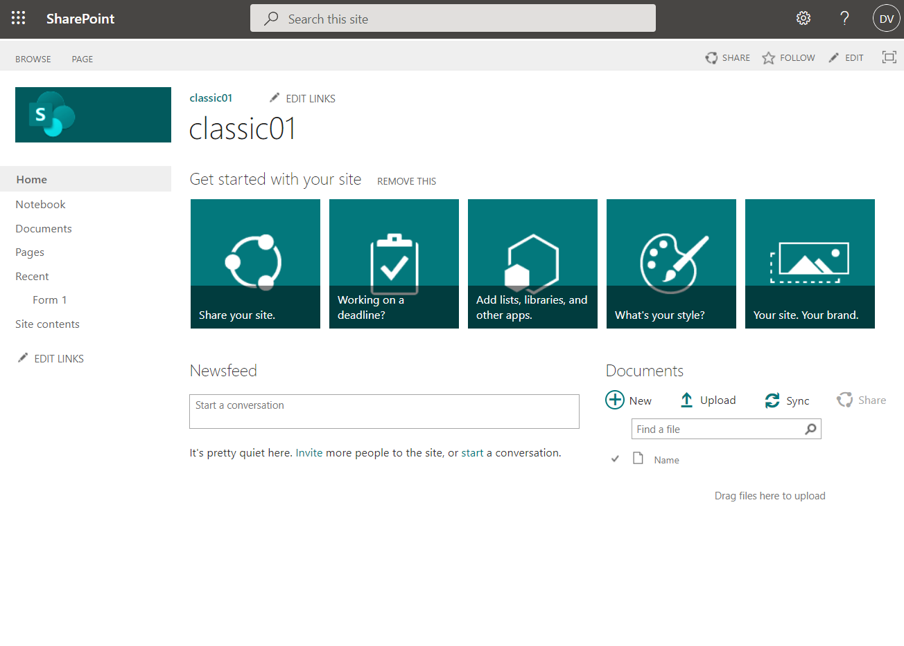
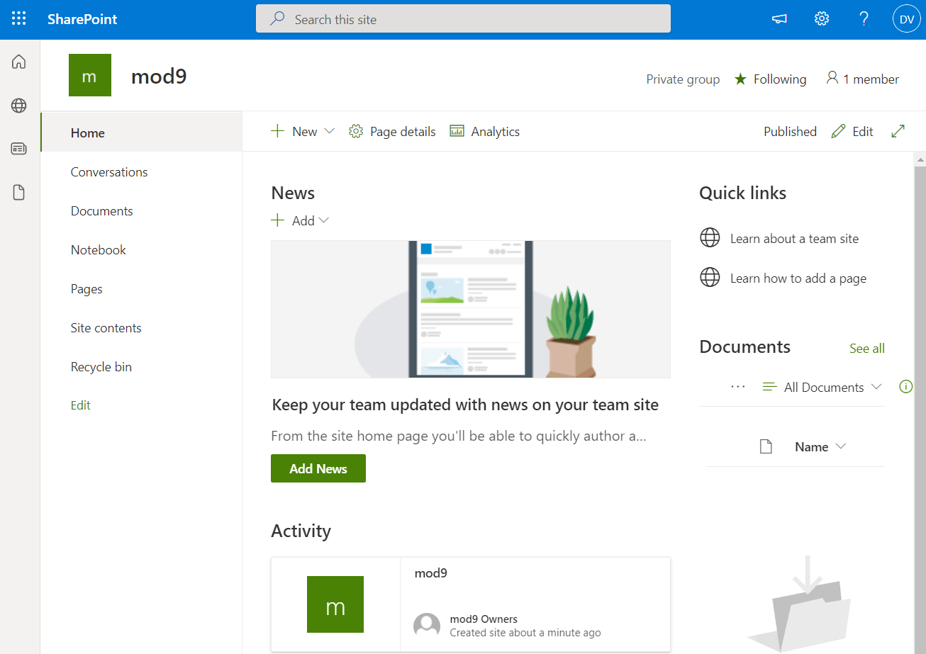
Modernization of Team Sites
Notes:
Differences between modern and classic sites: https://support.office.com/en-us/article/Differences-between-the-new-and-classic-experiences-for-lists-and-libraries-30e1aab0-a5cc-4363-b7f2-09e2ae07d4dc

Slide 18
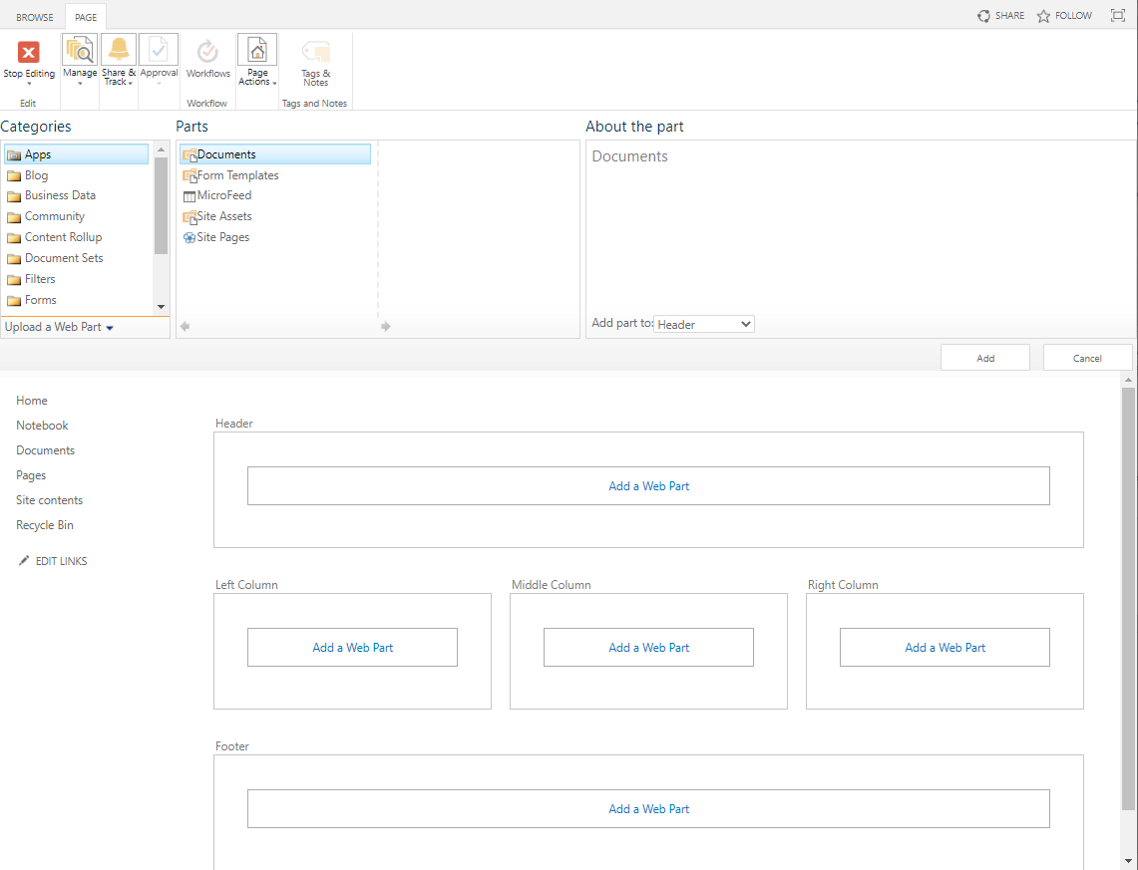
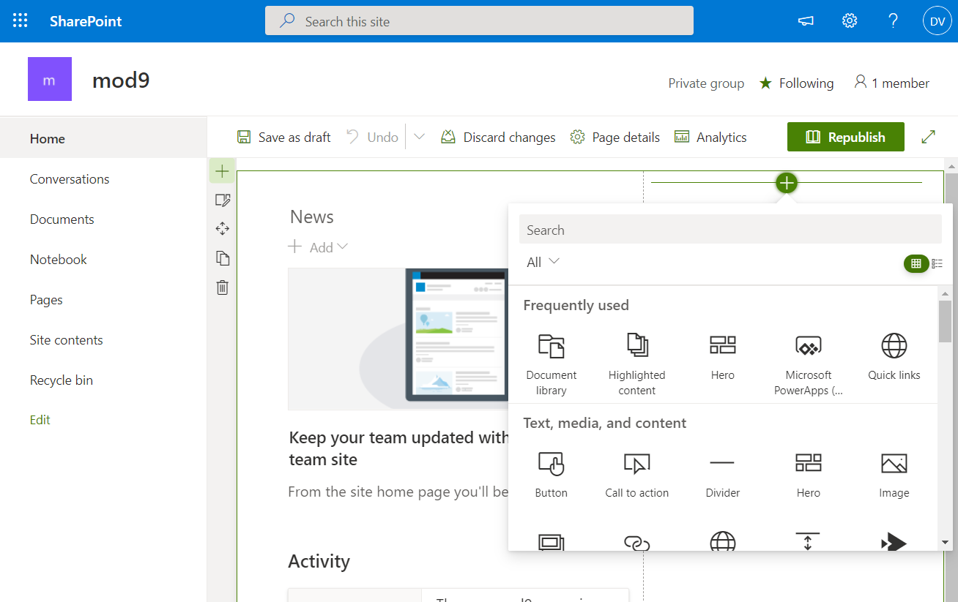
Modernization of UI - Pages and Web Parts
Notes:
Differences between modern and classic sites: https://support.office.com/en-us/article/Differences-between-the-new-and-classic-experiences-for-lists-and-libraries-30e1aab0-a5cc-4363-b7f2-09e2ae07d4dc
SharePoint classic and modern experiences - https://support.office.com/en-us/article/SharePoint-classic-and-modern-experiences-5725c103-505d-4a6e-9350-300d3ec7d73f

Slide 19
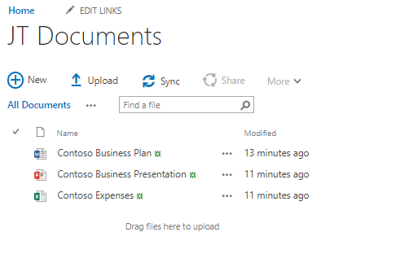
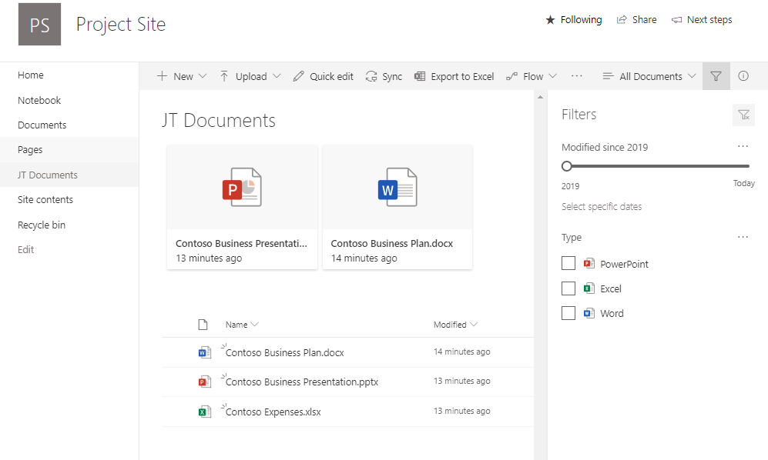
Modernization of UI – List and Libraries
Notes:
Differences between modern and classic sites: https://support.office.com/en-us/article/Differences-between-the-new-and-classic-experiences-for-lists-and-libraries-30e1aab0-a5cc-4363-b7f2-09e2ae07d4dc

Slide 20
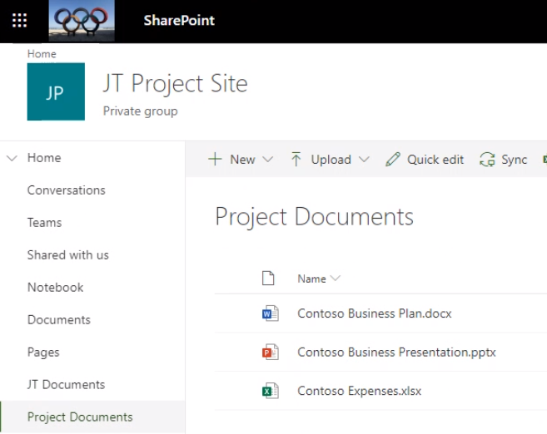
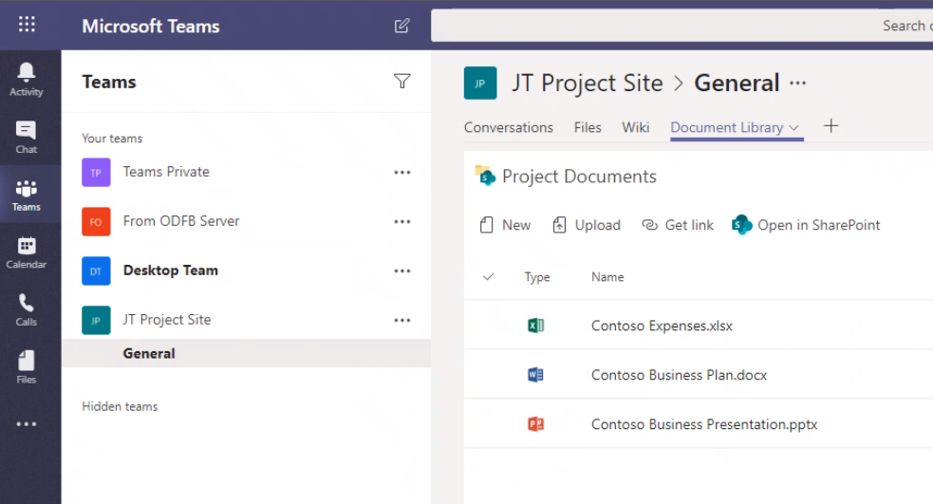
Modernization of Collaboration

Slide 21
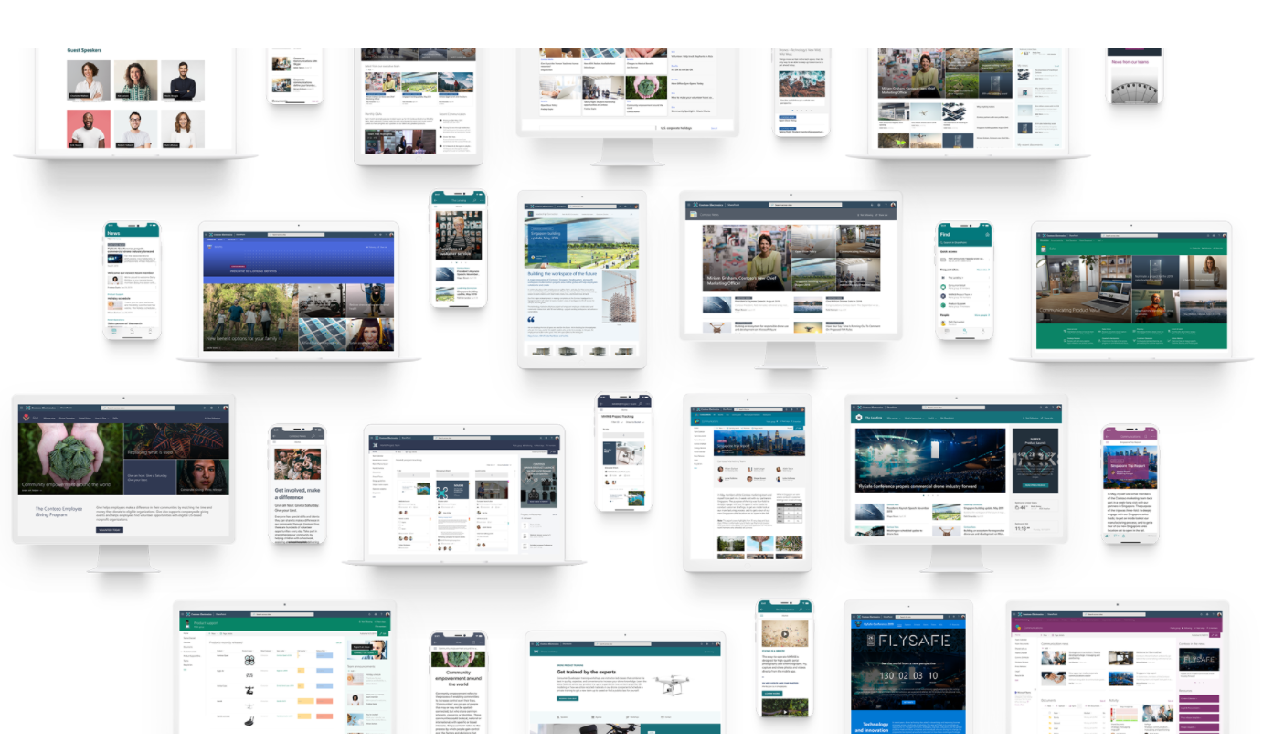
Modernization of Portals
https://lookbook.microsoft.com/
Notes:
Communication sites
SharePoint Mobile app
Responsive design
SharePoint Look book
SharePoint templates

Slide 22
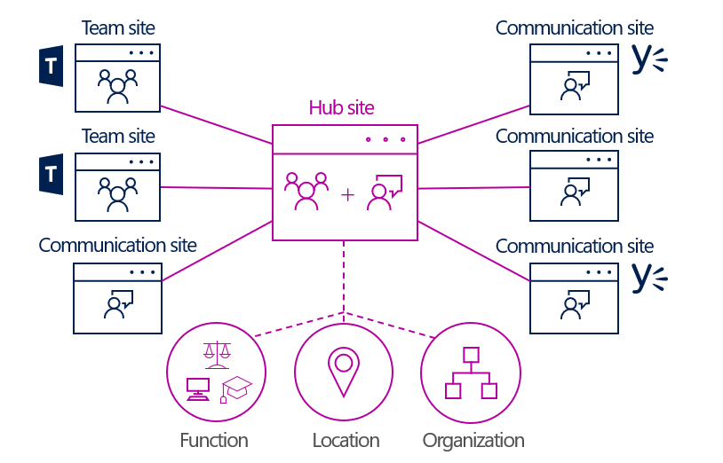
Modernization Strategy: Hub Sites
Hubs organize/link sites based on function, organization, or geography.
Hubs provides Inheritance of:
Navigation
Site Theme
Logo
Hub rolls up activity
Search scope for associated sites
Ability to inherit permissions
Flexibility to join and leave Hubs
Parent / Child Hubs
http://aka.ms/PlanningSPhubsites
Notes:
Reference:
Information architecture in modern SharePoint
https://docs.microsoft.com/en-us/sharepoint/information-architecture-modern-experience
Reference:
Information architecture in modern SharePoint
https://docs.microsoft.com/en-us/sharepoint/information-architecture-modern-experience
Set up your SharePoint hub site
https://support.microsoft.com/en-gb/office/set-up-your-sharepoint-hub-site-e2daed64-658c-4462-aeaf-7d1a92eba098

Slide 23
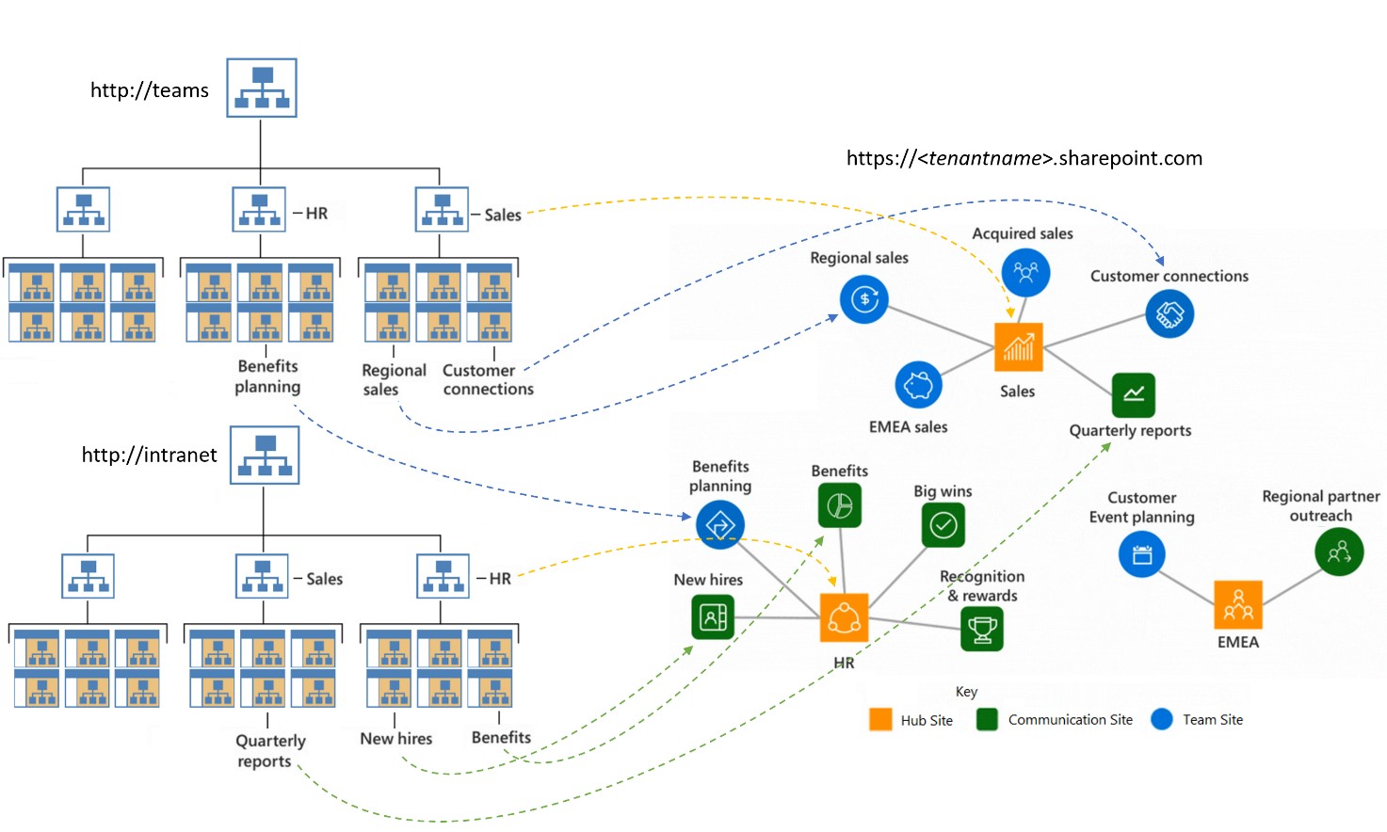
Modernization Strategy: Flatten Information Architecture
https://docs.microsoft.com/en-us/sharepoint/information-architecture-modern-experience
Notes:
Classic SharePoint architecture is typically built using a hierarchical system, including multiple web applications, custom managed paths, host header named site collections, and nested sub sites.
In SharePoint Online, your sites share a single tenant and standard managed paths: /teams/, /sites/
Hub sites, external sharing, and other governance features are scoped to the Site Collection level.
Migrate into a flat information architecture.

Slide 24
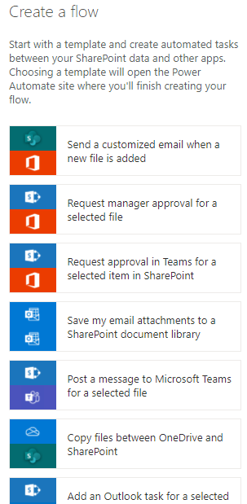
Modernization Strategy: Workflows
2010 workflows are disabled in SharePoint Online (as of Nov 2020)
2010 OOTB workflows can be migrated to Power Automate automatically using SPMT (as of Feb 2022)*
2013 Workflows continue to be supported - although deprecated.
Recreate workflows in Power Automate.
Microsoft offerings:
Activate SharePoint Workflow to Power Automate
https://aka.ms/sp-workflows-update
* Workflows created with SharePoint Designer or SharePoint Server 2013 currently not supported.
https://aka.ms/sp-workflows-support

Slide 25
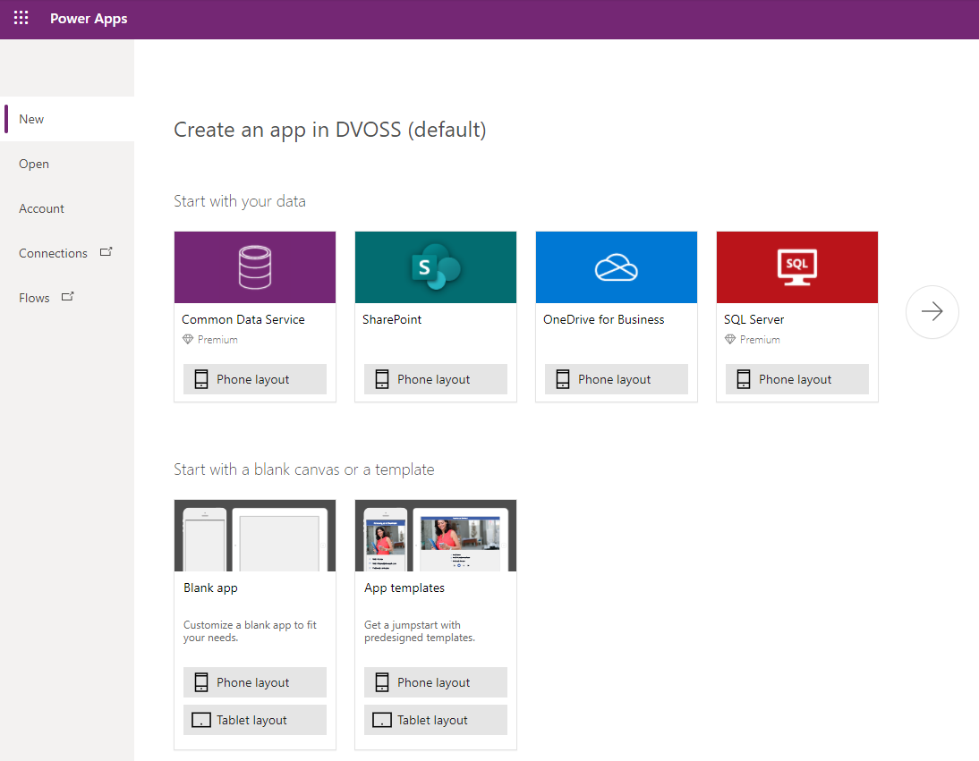
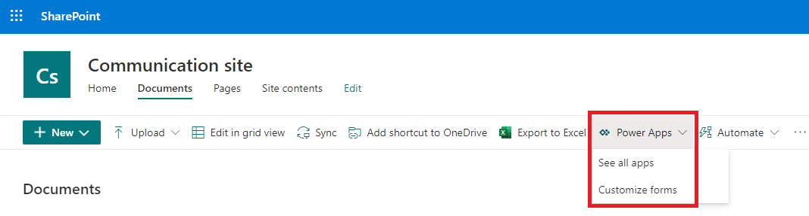
Modernization Strategy: Forms
Consider replacing InfoPath Forms with PowerApps.
PowerApps include built-in templates and connects to all M365 services.
Supports new functionality not available to InfoPath.
Microsoft offerings:
Activate Microsoft 365: Migrate InfoPath Forms to PowerApps (coming soon)
Activate Power Platform: Building a Power App

Slide 26
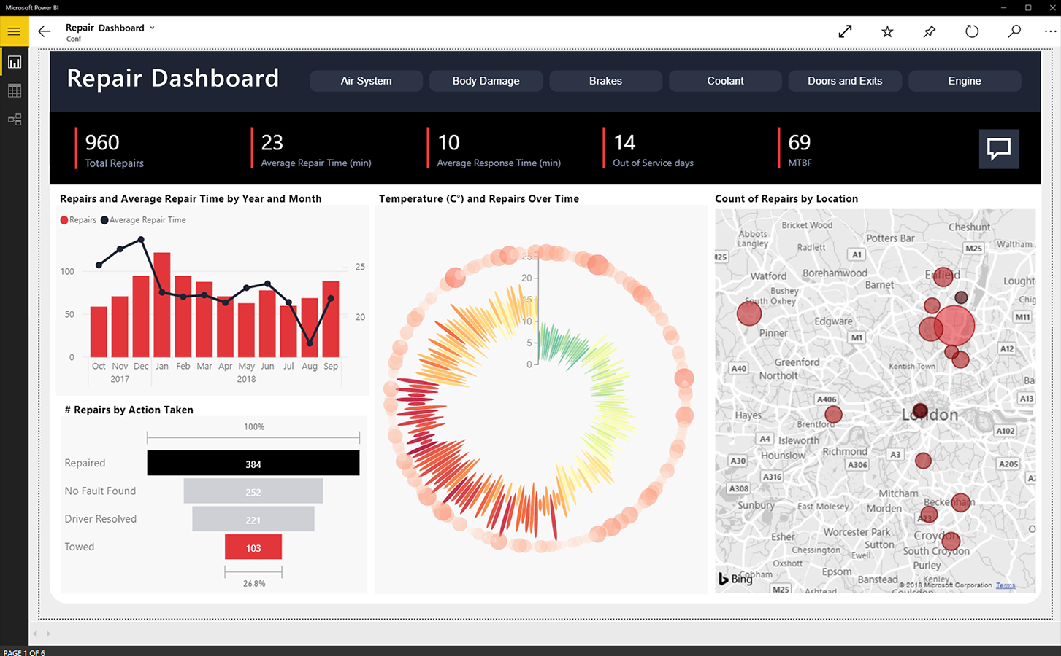
Modernization Strategy: Business Intelligence
SharePoint Online does not support SSRS, PowerPivot or PerformancePoint.
Recreate dashboards and reports in Power BI.
Power BI is a successor to the classic business intelligence products.
Power BI webparts can be added to SharePoint, Microsoft Teams or accessed through the App.
Notes:
PowerBI is a successor, not a replacement, for SSRS, PowerPivot and PerformancePoint
Existing Dashboard and reports will have to be rebuilt in PowerBI but you might be able to use your current data sources
SharePoint Online does not support SSRS, PowerPivot or PerformancePoint. If you need to continue to use this functionality you should consider PowerBI, Azure SQL solutions or SSRS native mode.
PowerBI webparts can be added to your SharePoint pages to display information to user.

Slide 27
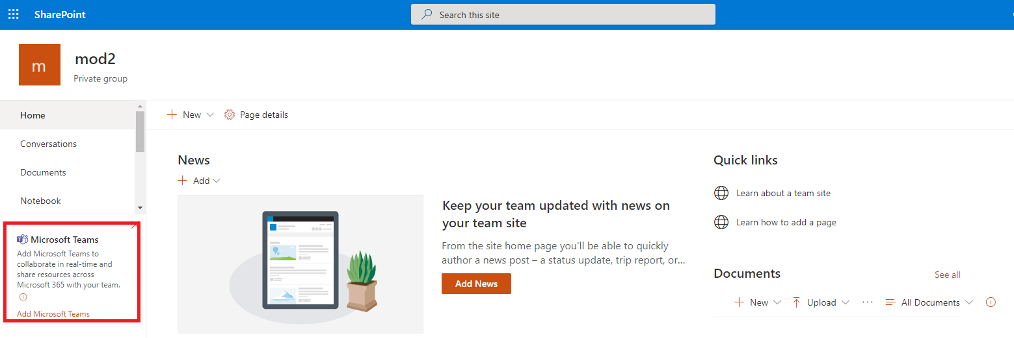
Modernization Strategy: Collaboration
Migrate classic team sites (STS#0) in SharePoint Server to Modern Team Sites (STS#3) in SharePoint Online.
Connect Modern Team Sites to Microsoft 365 Groups.
Add Microsoft Teams.

Slide 28
Modernization Strategy: Security and Compliance
Many security and compliance features are only available in M365 (there is no on-premises equivalent feature).
Replace legacy security and compliance features with M365 built-in capabilities:
SharePoint Server
eDiscovery Sites
Information Management Policies
Microsoft 365 Security and Compliance
Retention Labels
Sensitivity Labels
Site Auditing
Content Type Auditing
eDiscovery Cases
Tenant Audit Log
Cloud App Security
Rights Management

Slide 29
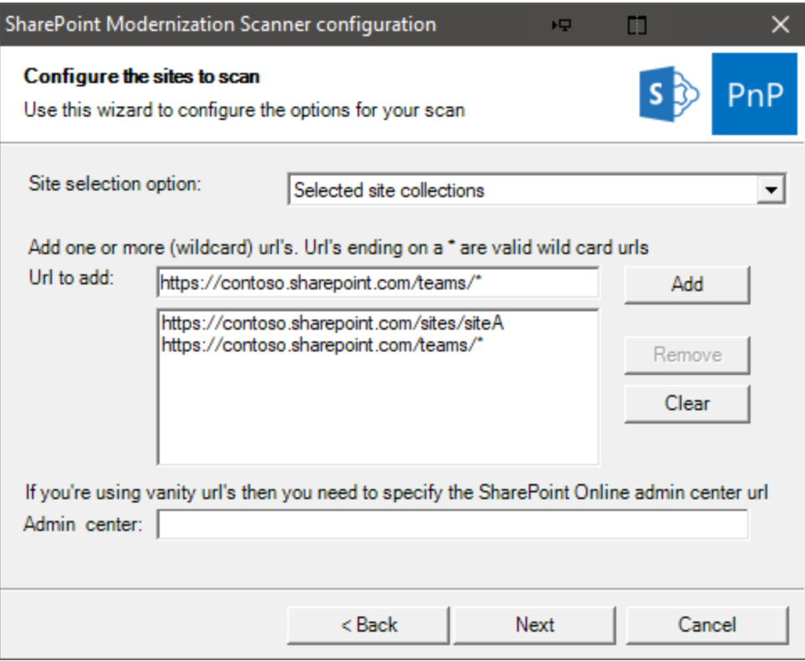
Modernization Scanner
Tool that will scan your tenant to identify sites that can be modernized.
For organizations that have existing Classic workloads in SharePoint Online.
Provides reports with guidance on several modernization issues.
Requires admin to set up an authentication strategy for the scanner.
https://docs.microsoft.com/en-us/sharepoint/dev/transform/modernize-scanner
Notes:
IMPORTANT This tool is not related to migration to SharePoint Online – but can help target existing tenants that may have classic sites.

Slide 30
Go-live Cutover Considerations

Slide 31

Go-live Cutover Considerations Overview
Block access to the source environment by using read-only mode, have it act as a redirect, or make it offline.
Choose an approach: Incremental or Full Cutover
Migrate in waves that can be staggered and overlapped.
Schedule migration using a migration plan.

Slide 32
Go-live Migration Approach - Incremental
Good for larger/complex sites.
Shrinks downtime experienced by users.
Initial “full” migration completed while users are still accessing the source.
Post migration configuration on the target may be required (Workflows, Forms, etc.)
Schedule cutover migration when source environment can be put in Read-Only mode (Night, Weekend, etc.).
Check-in all files. (Checked-out files DO NOT migrate)
Set source environment to Ready-Only.
Perform final incremental migration.
SPMT incremental DOES NOT migrate ALL changes, for example: views, permissions, changes to web parts. SPMT incremental good for file/item changes.

Slide 33
Go-live Migration Approach - Incremental Example

Slide 34
Go-live Migration Approach - Full
Check-in all files.
Source content is set to Read-Only (or made unavailable to the users)
Start Full migration to SharePoint Online target.
Recommended for smaller/less-complex sites.
Users cannot modify content on the sources until migration is complete.
Post migration configuration may be required on the destination before ready for users.
Full migrations can lead to extended downtimes! Consider using multiple migration machines to speed things up.

Slide 35
Go-live Migration Approach - Full Example

Slide 36
Staggered Overlap Wave - Example
Notes:
Example of a Stagger Overlap wave

Slide 37
Migration Plan - Example
Notes:
Wave migration plan example

Slide 38
Plan for Communication

Slide 39


Plan for Communication Overview
Communication plan should make clear statements of timing, expectations and impact, including:
The migration timeline
How it will impact the users.
Call out end user calls to action.
Assure users that existing content is safe.
Training materials, how-to-guides, and best practices.
There are a variety of Microsoft Fast Track resources available for communication plans. (Details on next slide.)
Notes:
Develop a plan for sending communications to the user base and business stakeholders.
Use communication templates and guides to help drive adoption of Microsoft 365 within the organization.
Communication plans should include clear statements of timing, expectations and impact, including:
The migration timeline and how it will impact the users.
Call out end user calls to action.
Assure users that existing content is safe – nothing will be overwritten.
Include training materials, how-to-guides, and best practices.
There are a variety of Microsoft Fast Track resources available for communication plans.

Slide 40
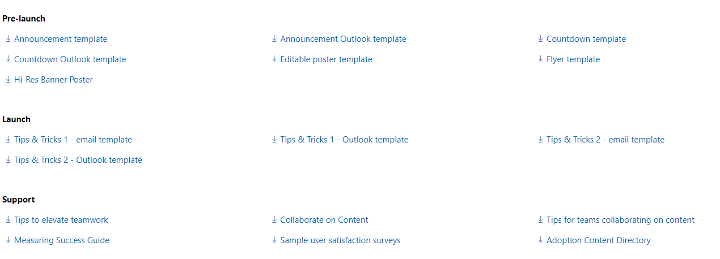
Resources for Communication
FastTrack resources for communication:
https://www.microsoft.com/en-us/fasttrack/resources?rtc=1
Notes:
Click on SharePoint category.

Slide 41

Empty slide with MS Logo

